Slide 1
PRIMALITY TESTING
Application
RSA Cryptosystem
Project by:
Prerak Agarwal (220818)
Suryansh Goel (221111)
Raghav Madan (220853)

Slide 2



A motivating example from real world
Internet
Enter credentials
Verify Credentials
and
proceed with transaction
We need a cryptosystem to prevent hackers from stealing sensitive information

Slide 3

RSA Cryptosystem (Rivest, Shamir and Adleman, $1977$)
It is a public-key cryptosystem that uses a pair of keys for secure communication:
Public key (e,n): Used to encrypt data (available publicly)
Private key (d,n): Used to decrypt data (only present with the receiver)
Encrypt the message using public key
c=m^{e} mod n
(size of m is smaller than n)
Transmit the cyphertext c
Decrypt the cyphertext using the private key to recover original message
m=c^{d} mod n
Message m
Receiver

Slide 4
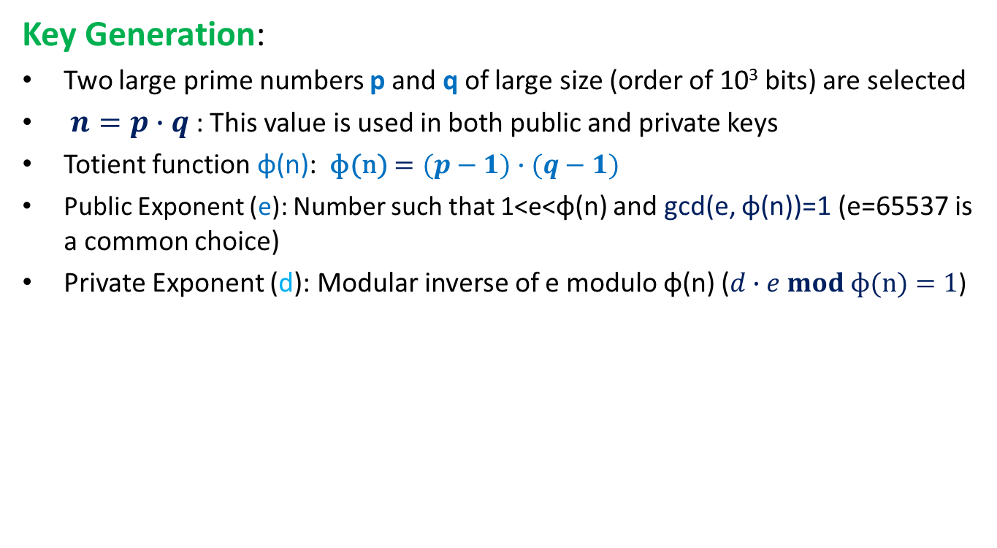
RSA Cryptosystem (Rivest, Shamir and Adleman, $1977$)
Key Generation:
Two large prime numbers p and q of large size (order of 10³ bits) are selected
$n=p∙q$ : This value is used in both public and private keys
Totient function ɸ(n): ɸ(n)$=(p−1)∙(q−1)$
Public Exponent (e): Number such that 1<e<ɸ(n) and gcd(e, ɸ(n))=1 (e=65537 is a common choice)
Private Exponent (d): Modular inverse of e modulo ɸ(n) ($d∙e mod \text{ɸ(}\text{n}\text{)}=1$)

Slide 5
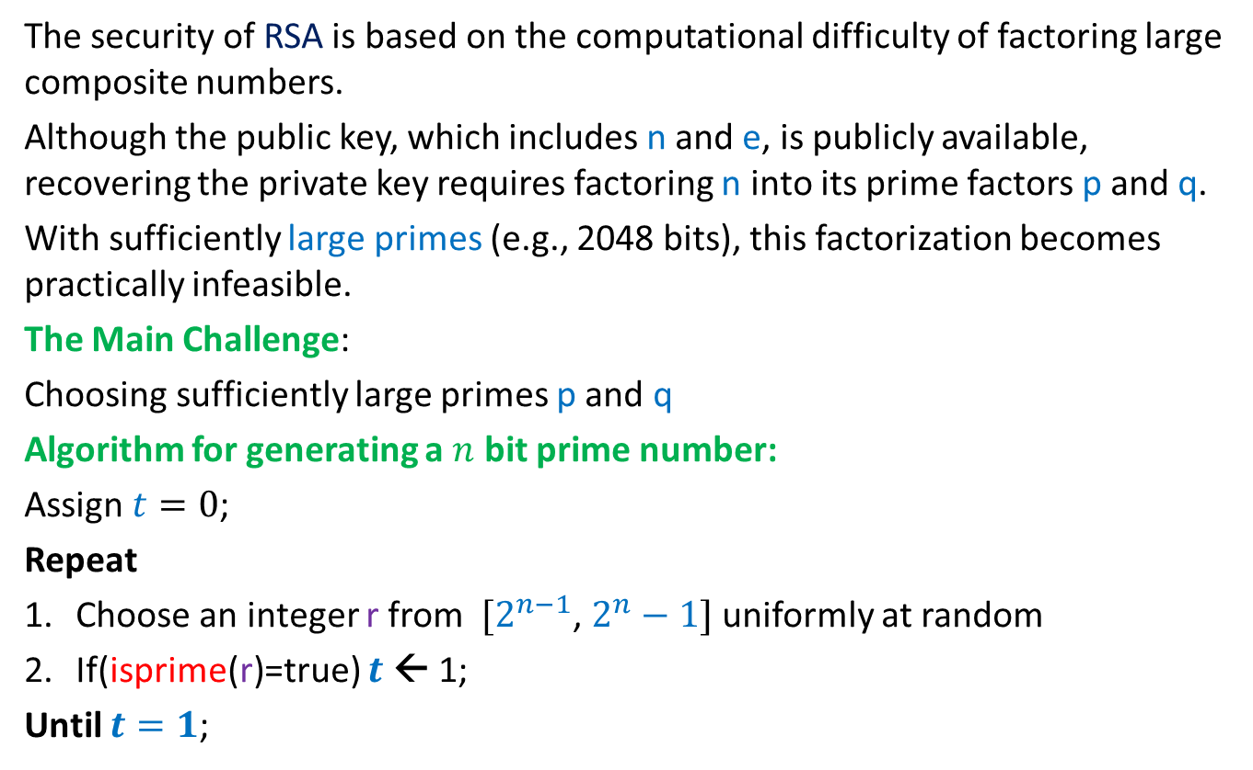
How secure is RSA cryptosystem?
The security of RSA is based on the computational difficulty of factoring large composite numbers.
Although the public key, which includes n and e, is publicly available, recovering the private key requires factoring n into its prime factors p and q.
With sufficiently large primes (e.g., 2048 bits), this factorization becomes practically infeasible.
The Main Challenge:
Choosing sufficiently large primes p and q
Algorithm for generating a $n$ bit prime number:
Assign $t=0$;
Repeat
Choose an integer r from $[2^{n−1}$, $2^{n}−1]$ uniformly at random
If(isprime(r)=true) $t$← 1;
Until $t=1$;
This leads us to the question:
How can we determine if a n bit integer is prime in optimal time ? (n is of the order of 10³ bits)

Slide 6
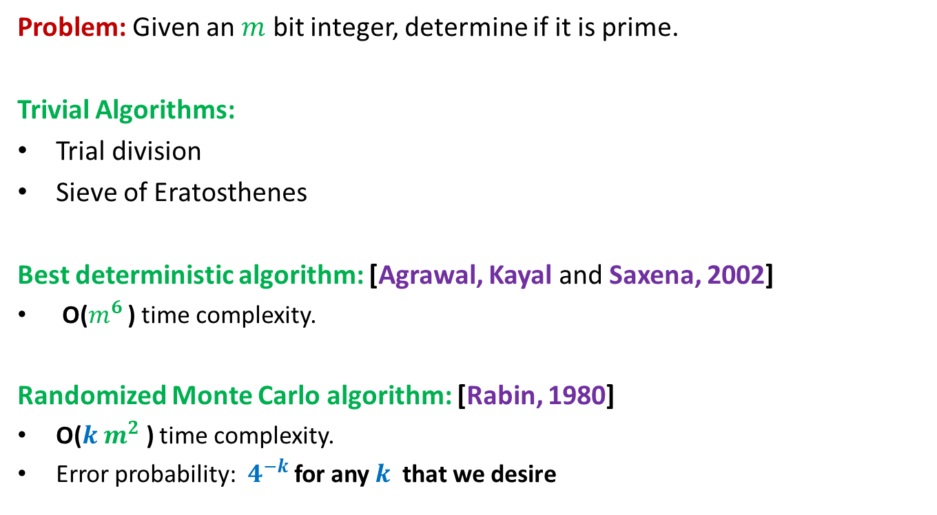
Primality Testing
Problem: Given an $m$ bit integer, determine if it is prime.
Trivial Algorithms:
Trial division
Sieve of Eratosthenes
Best deterministic algorithm: [Agrawal, Kayal and Saxena, 2002]
O($m^{6}$ ) time complexity.
Randomized Monte Carlo algorithm: [Rabin, 1980]
O($k$ $m^{2}$ ) time complexity.
Error probability: $4^{−k}$ for any $k$ that we desire
Exponential time Algorithms
Difficult to implement and involves complex computations
Uses elementary number theory
Easy to implement
Simple and elegant
Aim: To design a randomized Monte Carlo Algorithm for checking if a m bit number 𝑛 is prime or not.

Slide 7
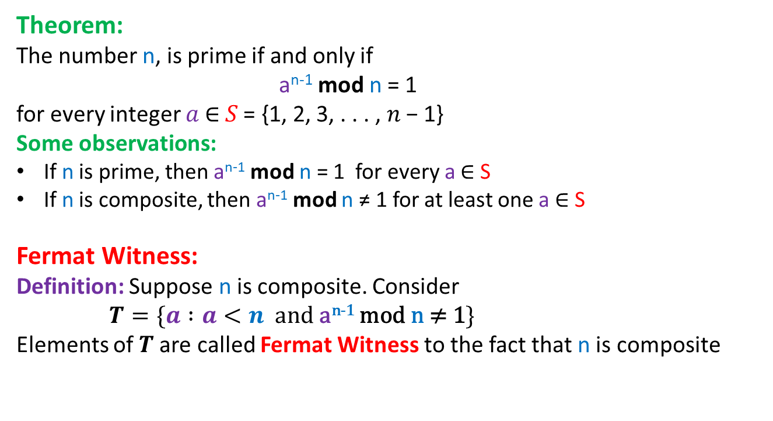
Fermat Little Theorem
Theorem:
The number n, is prime if and only if
a^{n-1} mod n = 1
for every integer 𝑎 ∈ 𝑆 = {1, 2, 3, . . . , 𝑛 − 1}
Some observations:
If n is prime, then a^{n-1} mod n = 1 for every a ∈ S
If n is composite, then a^{n-1} mod n ≠ 1 for at least one a ∈ S
Fermat Witness:
Definition: Suppose n is composite. Consider
$T=\{a :a<n and \text{a}\text{n}\text{−1 }\text{mod} \text{n}\text{ ≠ 1}\}$
Elements of $T$are called Fermat Witness to the fact that n is composite

Slide 8



Some more witnesses
Divisor Witness:
Definition: Suppose n is composite.
If there exist some 𝑘 ∈ 𝑆 = {2, 3, 4, . . . , 𝑛 − 1} such that 𝑘 ǀ 𝑛,
then k is a divisor witness to n being composite.
GCD Witness:
Definition: Suppose n is composite.
If there exists some 𝑎 ∈ {1, 2, 3, . . ., 𝑛 − 1} such that gcd(𝑎,𝑛) > 1,
then 𝑎 is a GCD witness to n being composite.
Theorem 1:
For every composite number 𝑛, every divisor witness of 𝑛’s compositeness is also a gcd witness, and every gcd witness is also a Fermat witness.
$$fermat$$
$$gcd$$
$$divisor$$

Slide 9
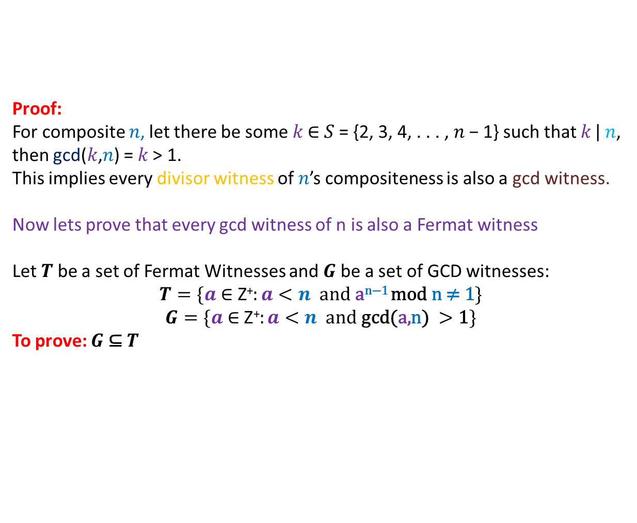
Theorem 1:
For every composite number 𝑛, every divisor witness of 𝑛’s compositeness is also a gcd witness, and every gcd witness is also a Fermat witness.
Proof:
For composite 𝑛, let there be some 𝑘 ∈ 𝑆 = {2, 3, 4, . . . , 𝑛 − 1} such that 𝑘 ǀ 𝑛,
then gcd(𝑘,𝑛) = 𝑘 > 1.
This implies every divisor witness of 𝑛’s compositeness is also a gcd witness.
Now lets prove that every gcd witness of n is also a Fermat witness
Let $T$ be a set of Fermat Witnesses and $G$ be a set of GCD witnesses:
$$T=\{a \text{∈} \text{Z}\text{+}:a<n and \text{a}\text{n}\text{−1 }\text{mod} \text{n}\text{ ≠ 1}\}$$
$$G=\{a \text{∈ }\text{Z}\text{+}:a<n and \text{gcd}\text{(}\text{a}\text{,}\text{n}\text{)} >\text{1}\}$$
To prove: $G$ ⊆ $T$

Slide 10
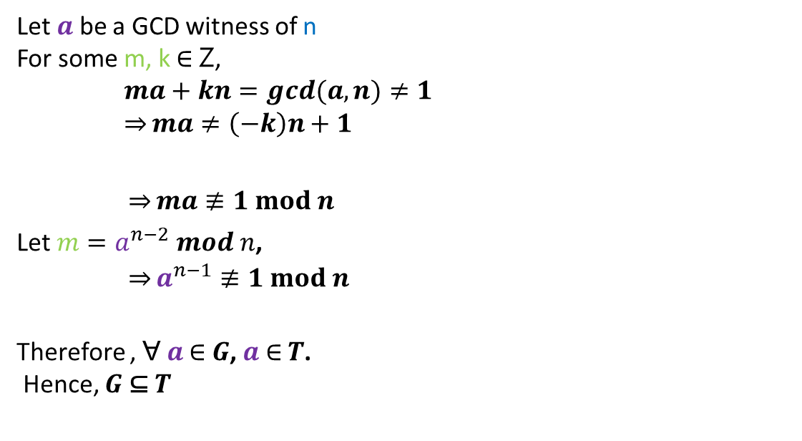

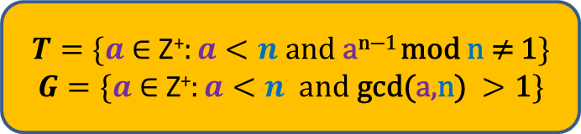
To prove: $G$ ⊆ $T$
$$T=\{a \text{∈ }\text{Z}\text{+}:a<n and \text{a}\text{n}\text{−1 }\text{mod} \text{n}\text{ ≠ 1}\}$$
$$G=\{a \text{∈ }\text{Z}\text{+}:a<n and \text{gcd}\text{(}\text{a}\text{,}\text{n}\text{)} >\text{1}\}$$
Let $a$ be a GCD witness of n
For some m, k ∈ ꓜ,
$ma+kn=gcd(a,n)≠1$
$\overset{⇒}{}ma≠\left(−k\right)n+1$
$\overset{⇒}{}ma≢1 mod n$
Let $m=a^{n−2} mod n$,
${ \overset{⇒}{}a}^{n−1}≢1 mod n$
Therefore , Ɐ $a$ $\text{∈}$ $G$, $a$ $\text{∈}$ $T$.
Hence, $G$ ⊆ $T$
Bezout’s identity
Take modulo n
Fact:
The number of divisor witnesses and GCD witnesses is very small,
while the number of Fermat witnesses is typically very high.

Slide 11
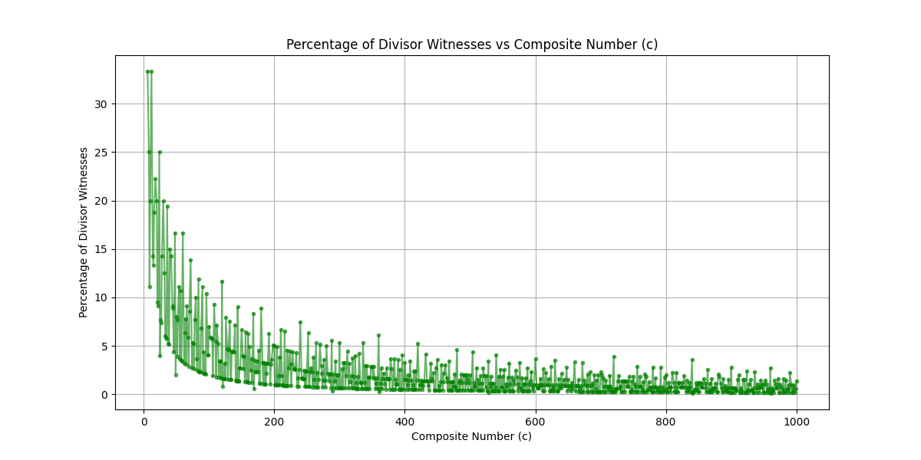
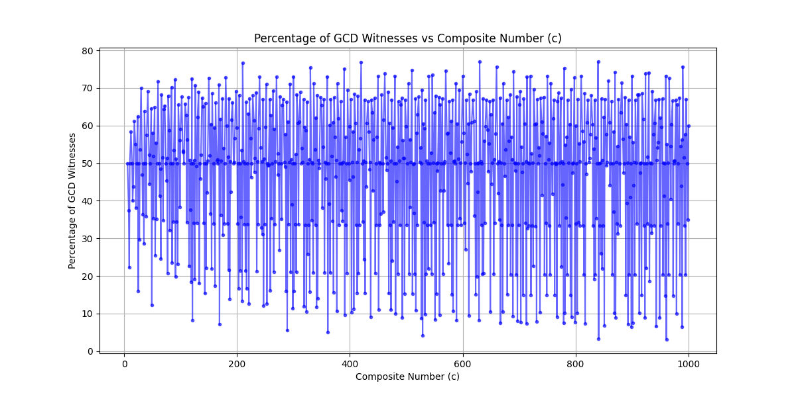
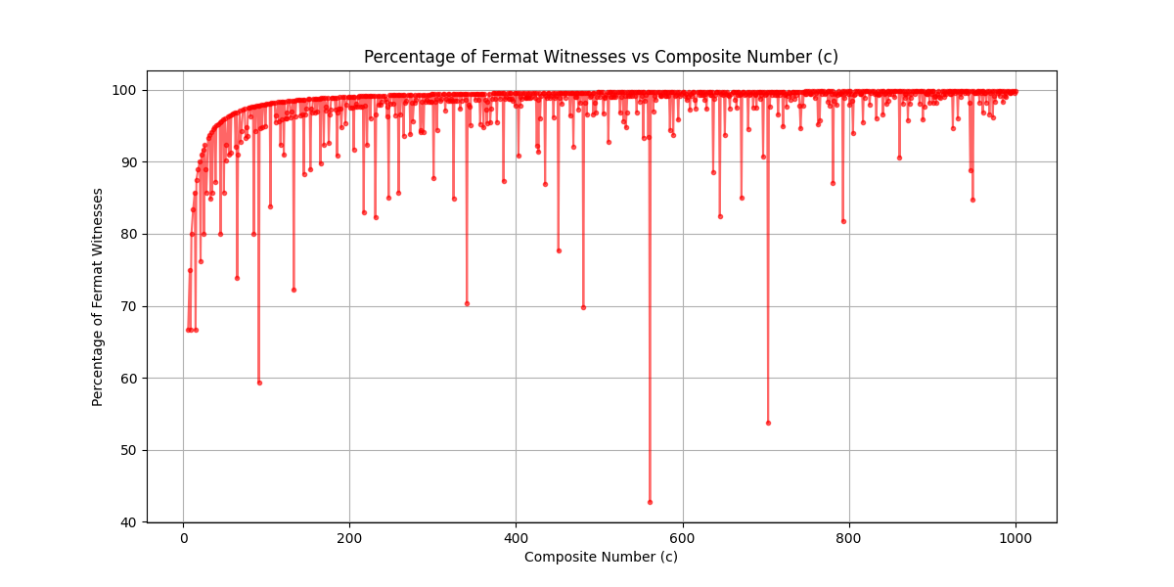
Fact:
The number of divisor witnesses and GCD witnesses is very small,
while the number of Fermat witnesses is typically very high.

Slide 12
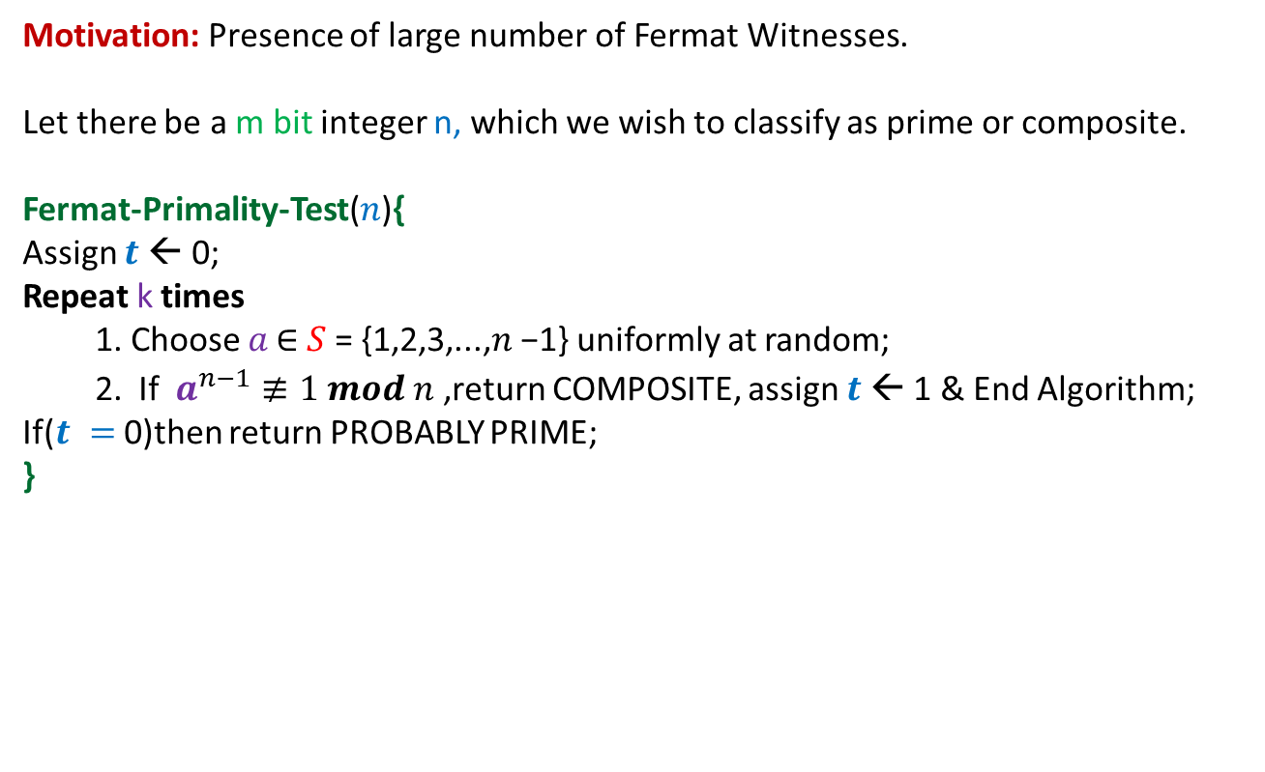
Fermat Primality Test
Motivation: Presence of large number of Fermat Witnesses.
Let there be a m bit integer n, which we wish to classify as prime or composite.
Fermat-Primality-Test($n$){
Assign $t$← 0;
Repeat k times
Choose 𝑎 ∈ 𝑆 = {1,2,3,...,𝑛 −1} uniformly at random;
If ${ a}^{n−1}≢1 mod n$ ,return COMPOSITE, assign $t$← 1 & End Algorithm;
If($t =$0)then return PROBABLY PRIME;
}

Slide 13




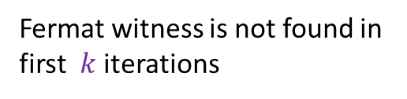
Error Analysis
Cases
$n$ is prime
No error
$n$ is composite
Fermat witness is not found in
first $k$ iterations
Suppose that we could say that for every composite number 𝑛,
at least half the 𝑎 ∈ 𝑆 = {1,2,3,...,𝑛 − 1} are Fermat witnesses.
Then, for a composite 𝑛, $P(a is NOT a fermat witness)≤\frac{1}{2}$
$P(fermat witness is not found in first k iterations)$ $≤{(½)}^{k}$
Error probability:
Is this assumption really true?
Let’s find out
$$≤{(½)}^{k}$$

Slide 14
Theorem 2:
For composite number 𝑛, suppose that there is at least one 𝑎 in 𝑆 = {1,2,3,...,𝑛−1} such that
𝑎 is a Fermat witness for 𝑛 but NOT a GCD witness (i.e gcd(𝑎,𝑛) = 1).
Then at least half the elements of 𝑆 are Fermat witnesses for 𝑛.
Observe: Even if there is just one non-GCD Fermat Witness (also called Non-trivial Fermat
Witness) for n, then there are plenty of Fermat Witnesses for n.
What about those numbers who have ZERO Non-Trivial Fermat Witnesses ?
Let’s find out

Slide 15
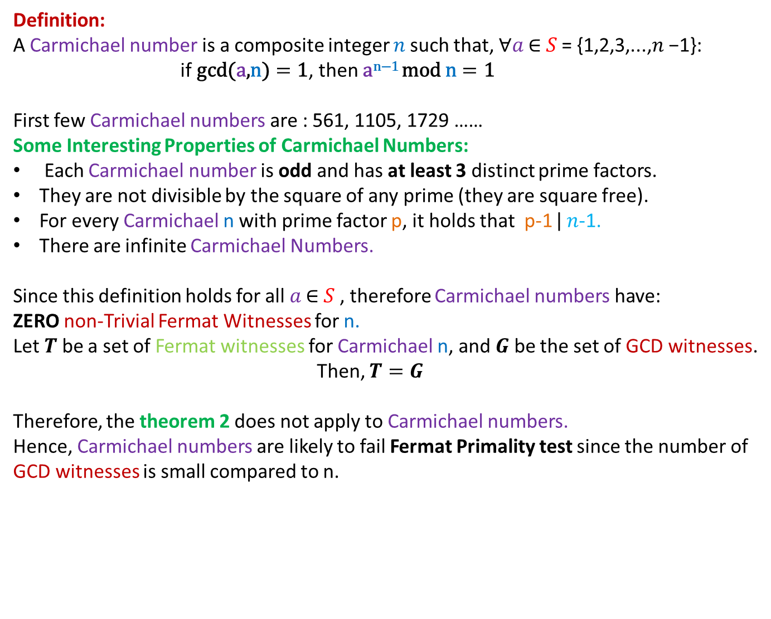
Carmichael Numbers
Definition:
A Carmichael number is a composite integer 𝑛 such that, ∀𝑎 ∈ 𝑆 = {1,2,3,...,𝑛 −1}:
if $\text{gcd}\text{(}\text{a}\text{,}\text{n}\text{)}=\text{1}$, then $\text{a}\text{n}\text{−1 }\text{mod} \text{n}=\text{1}$
First few Carmichael numbers are : 561, 1105, 1729 ……
Some Interesting Properties of Carmichael Numbers:
Each Carmichael number is odd and has at least 3 distinct prime factors.
They are not divisible by the square of any prime (they are square free).
For every Carmichael n with prime factor p, it holds that p-1 ǀ 𝑛-1.
There are infinite Carmichael Numbers.
Since this definition holds for all 𝑎 ∈ 𝑆 , therefore Carmichael numbers have:
ZERO non-Trivial Fermat Witnesses for n.
Let $T$ be a set of Fermat witnesses for Carmichael n, and $G$ be the set of GCD witnesses.
Then, $T=G$
Therefore, the theorem 2 does not apply to Carmichael numbers.
Hence, Carmichael numbers are likely to fail Fermat Primality test since the number of
GCD witnesses is small compared to n.

Slide 16
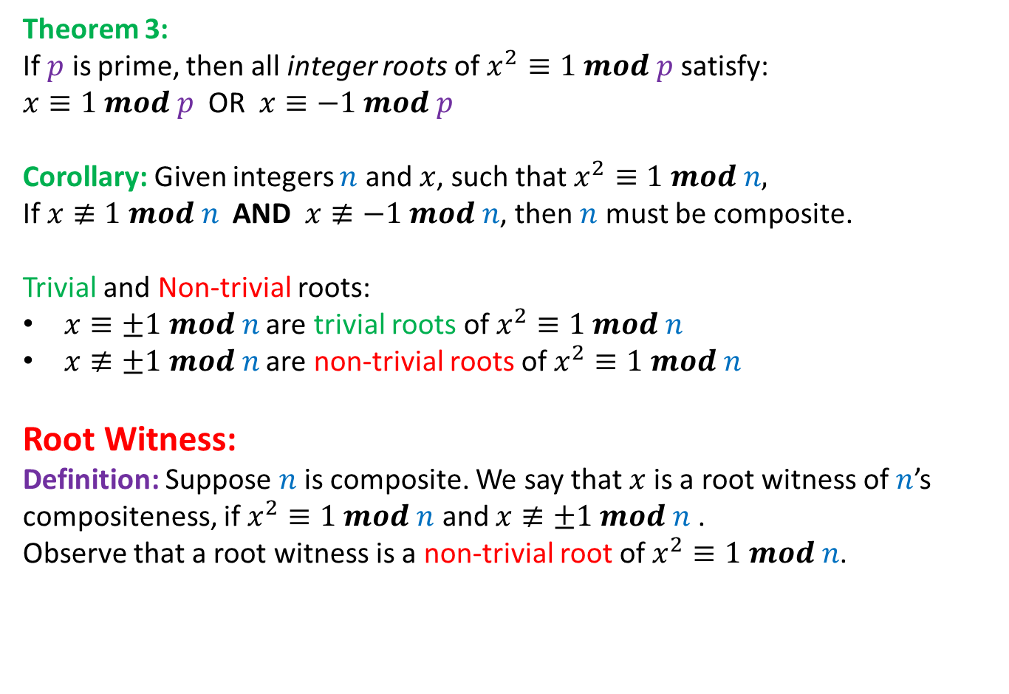
A new witness of Compositeness
Theorem 3:
If $p$ is prime, then all integer roots of $x^{2}≡1 mod p$ satisfy:
$x≡1 mod p$ OR $x≡−1 mod p$
Corollary: Given integers $n$ and $x$, such that $x^{2}≡1 mod n,$
If $x≢1 mod n$ AND $x≢−1 mod n$, then $n$ must be composite.
Trivial and Non-trivial roots:
$x≡±1 mod n$ are trivial roots of $x^{2}≡1 mod n$
$x≢±1 mod n$ are non-trivial roots of $x^{2}≡1 mod n$
Root Witness:
Definition: Suppose $n$ is composite. We say that $x$ is a root witness of $n$’s compositeness, if $x^{2}≡1 mod n$ and $x≢±1 mod n$ .
Observe that a root witness is a non-trivial root of $x^{2}≡1 mod n$.

Slide 17

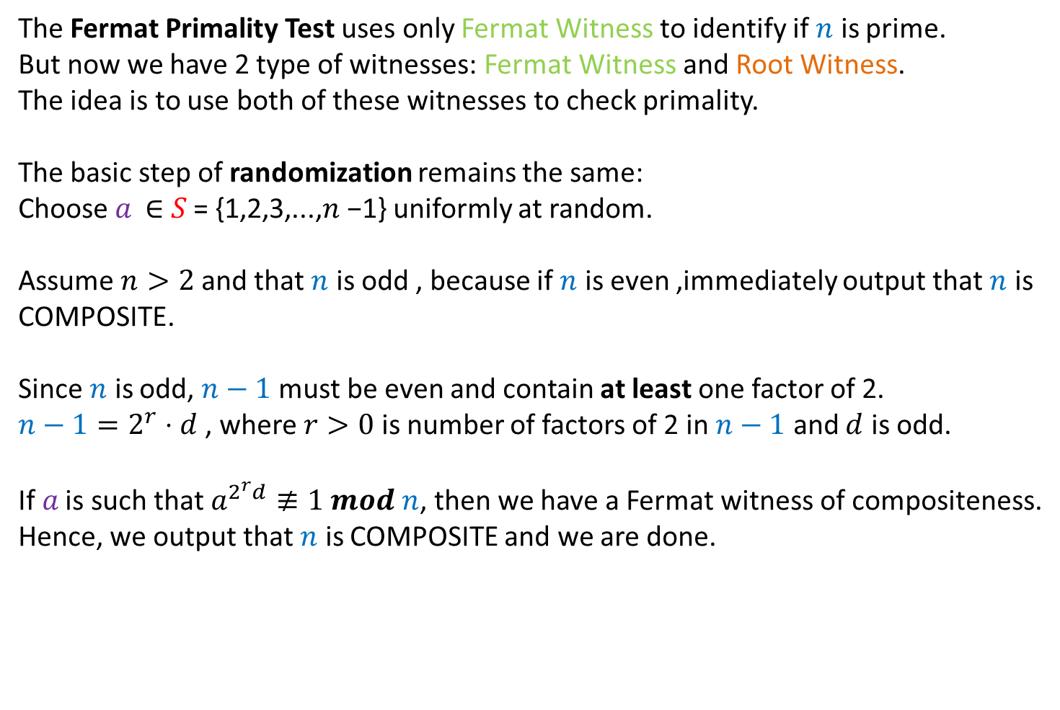
An Idea
The Fermat Primality Test uses only Fermat Witness to identify if $n$ is prime.
But now we have 2 type of witnesses: Fermat Witness and Root Witness.
The idea is to use both of these witnesses to check primality.
The basic step of randomization remains the same:
Choose 𝑎 ∈ 𝑆 = {1,2,3,...,𝑛 −1} uniformly at random.
Assume $n>2$ and that $n$ is odd , because if $n$ is even ,immediately output that $n$ is COMPOSITE.
Since $n$ is odd, $n−1$ must be even and contain at least one factor of 2.
${n−1=2}^{r}⋅d$ , where $r>0$ is number of factors of 2 in $n−1$ and $d$ is odd.
If 𝑎 is such that $a^{2^{r}d}≢1 mod n$, then we have a Fermat witness of compositeness.
Hence, we output that $n$ is COMPOSITE and we are done.
But what if 𝑎 is such that $a^{2^{r}d}≡1 mod n$ ?

Slide 18




Building the Algorithm
Suppose ${ a}^{2^{r}d}≡1 mod n$ .
We can rewrite this as ${{ (a}^{2^{r−1}d})}^{2}≡1 mod n$ since $r−1≥0$.
And now we check if this equation has a non-trivial root, that is,
If ${ a}^{2^{r−1}d}≢\left\{1, −1\right\} mod n$, then we have found a root witness of compositeness.
Hence, we output that $n$ is COMPOSITE and we are done.
Try to think it as a square equation
What if $a^{2^{r−1}d}≡\{1,−1\} mod n$ ?
$$a^{2^{r−1}d}≡1 mod n$$
If $r−1>0$, we get another chance to find a root witness of compositeness
$$a^{2^{r−1}d}≡−1 mod n$$
In this case we are done testing.
Since we have not found any witness , return “probably prime”.

Slide 19
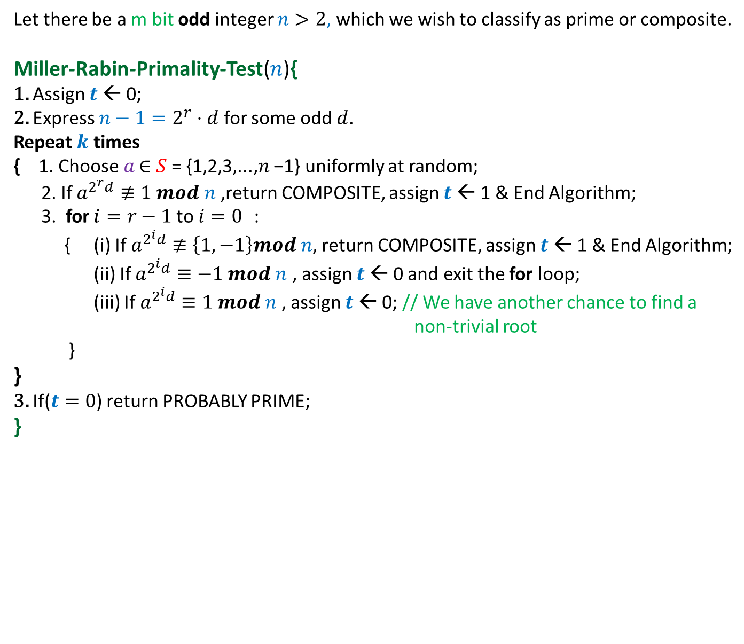
Miller-Rabin Primality Test
Let there be a m bit odd integer $n>2$, which we wish to classify as prime or composite.
Miller-Rabin-Primality-Test($n$){
1. Assign $t$← 0;
2. Express ${n−1=2}^{r}⋅d$ for some odd $d$.
Repeat $k$ times
{ 1. Choose 𝑎 ∈ 𝑆 = {1,2,3,...,𝑛 −1} uniformly at random;
2. If $a^{2^{r}d}≢1 mod n$ ,return COMPOSITE, assign $t$← 1 & End Algorithm;
3. for $i=r−1$to $i=0$ :
{ (i) If $a^{2^{i}d}≢\left\{1,−1\right\}mod n$, return COMPOSITE, assign $t$← 1 & End Algorithm;
(ii) If $a^{2^{i}d}≡−1 mod n$ , assign $t$← 0 and exit the for loop;
(iii) If $a^{2^{i}d}≡1 mod n$ , assign $t$← 0; // We have another chance to find a non-trivial root
}
}
3. If($t=0$) return PROBABLY PRIME;
}
This algorithm can be optimized by starting with $a^{d}$ and then repeatedly squaring it $r$ times,
instead of first computing $a^{2^{r}d}$ and then taking square roots.

Slide 20
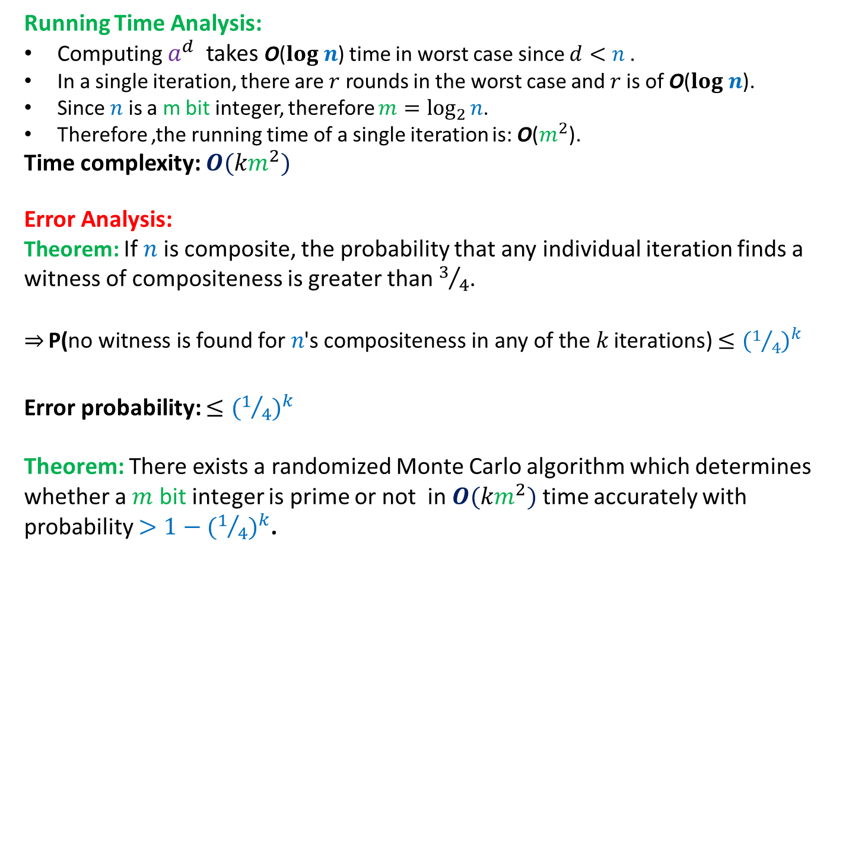
Analysis of the Algorithm
Running Time Analysis:
Computing $a^{d}$ takes O($log n$) time in worst case since $d<n$.
In a single iteration, there are $r$ rounds in the worst case and $r$is of O($log n$).
Since $n$ is a m bit integer, therefore $m=\log_{2}{n}$.
Therefore ,the running time of a single iteration is: O($m^{2}$).
Time complexity: $O({km}^{2})$
Error Analysis:
Theorem: If $n$is composite, the probability that any individual iteration finds a witness of compositeness is greater than $3/4$.
$\overset{⇒}{} \text{P}\text{(}\text{no} \text{witness} \text{is} \text{found} \text{for} \text{n}\text{′}\text{s} \text{compositeness} \text{in} \text{any} \text{of} \text{the} k \text{iterations}\text{)}$ $≤{(1/4)}^{k}$
Error probability: $≤{(1/4)}^{k}$
Theorem: There exists a randomized Monte Carlo algorithm which determines whether a $m$ bit integer is prime or not in $O({km}^{2})$ time accurately with probability ${>1−(1/4)}^{k}$.

Slide 21
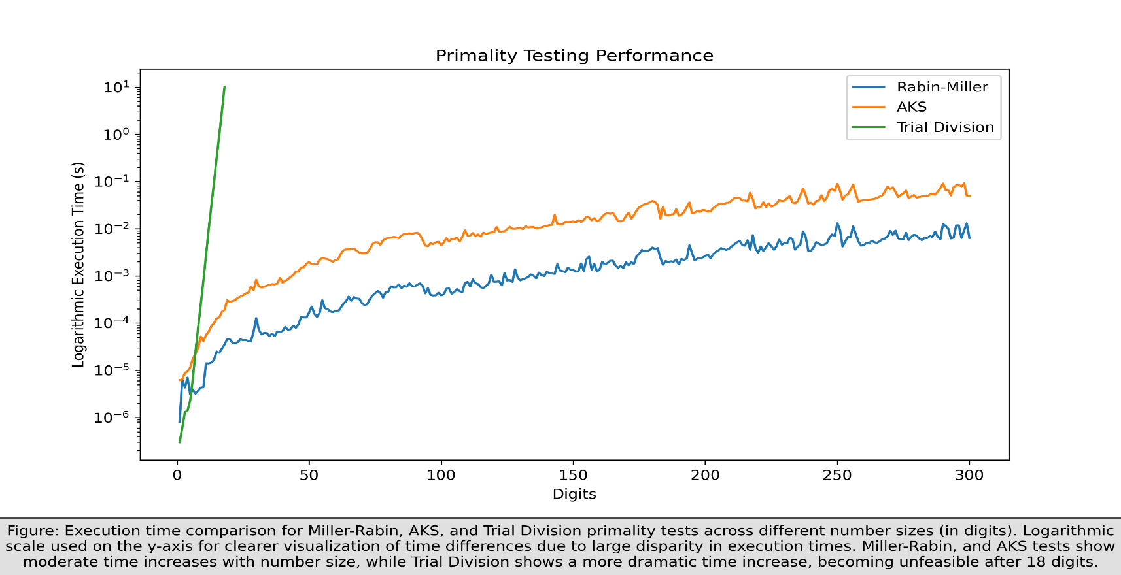
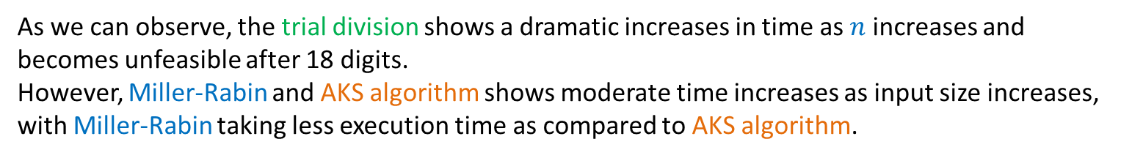
Experimental Results
Comparison between various primality testing algorithms:
We compared different algorithms for primality testing and plotted their execution time for different primes upto 300 digits.
As we can observe, the trial division shows a dramatic increases in time as $n$ increases and becomes unfeasible after 18 digits.
However, Miller-Rabin and AKS algorithm shows moderate time increases as input size increases,
with Miller-Rabin taking less execution time as compared to AKS algorithm.

Slide 22
Thank You
Now we will present the demo of our
Multi-user RSA encryption application

